Slide 1
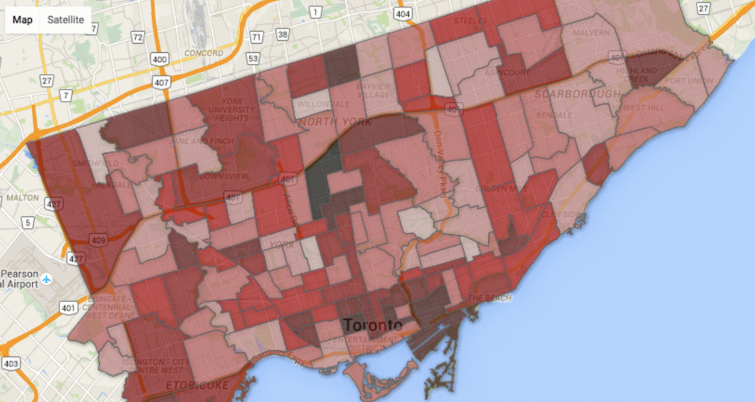
Where are Crimes Most Prevalent in Toronto?
Name: Vishal Naik
ID: 500884408

Slide 2
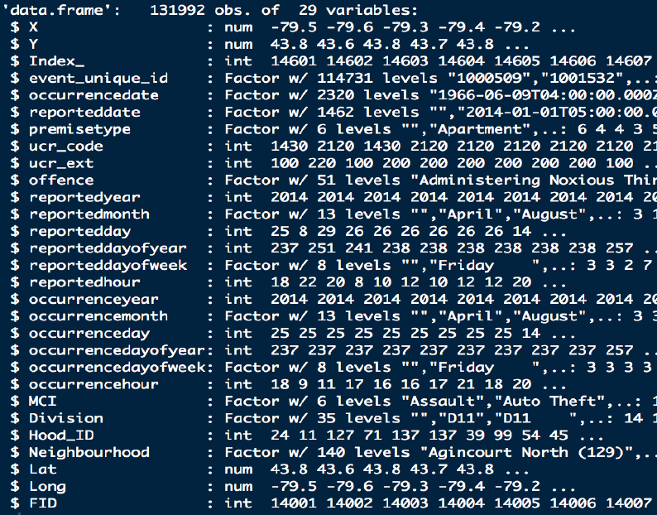
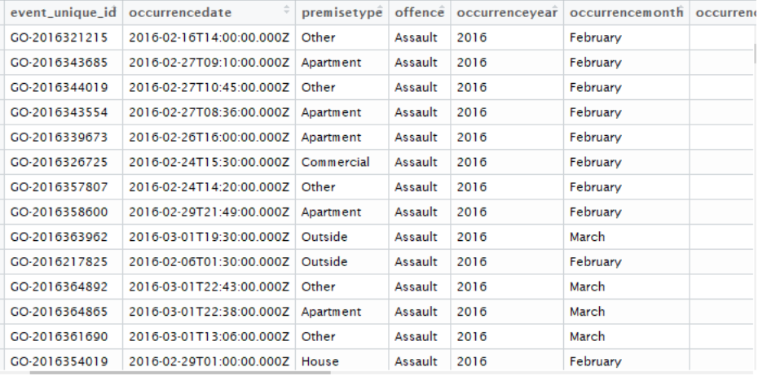
Introduction
Crime is a big concern for most people living in the city. People tend to want to live in areas that preferably have a low crime rate. The problem I am trying to solve revolves around the crime rate in Toronto. Where does it occur the most? And when?
As Toronto becomes more populated, the crime rate seems to increase. Toronto Police Services launched a public safety data portal to increase transparency between the public and officers.

Slide 3
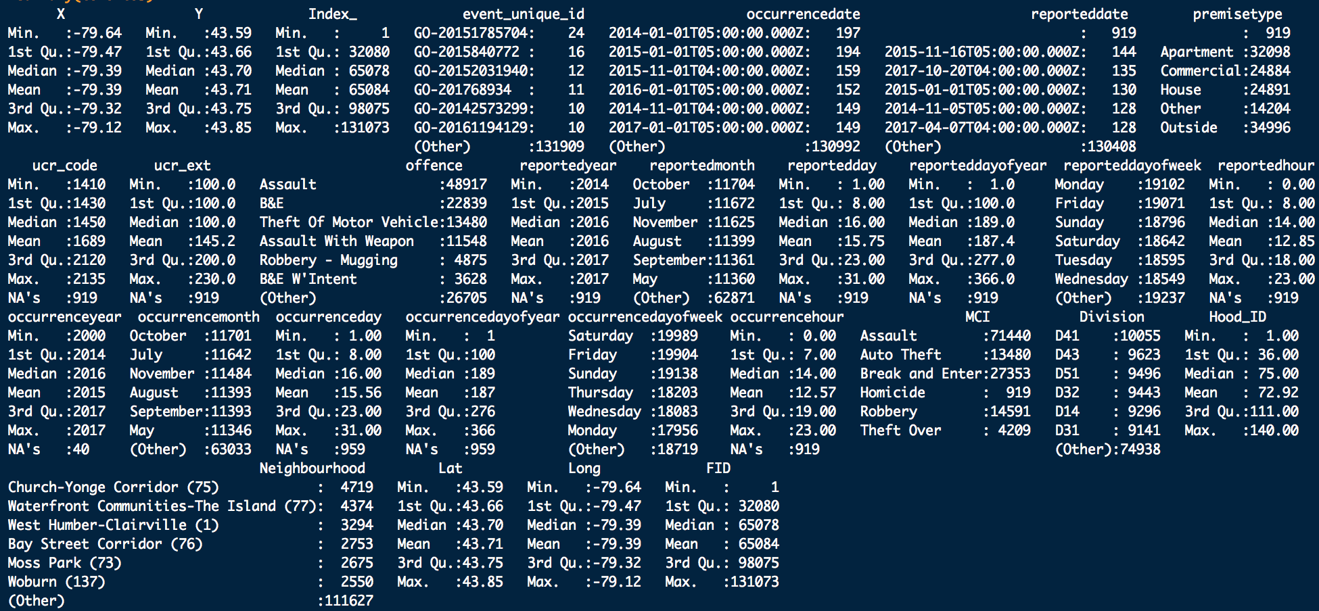

Slide 4
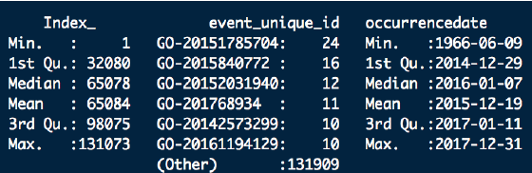
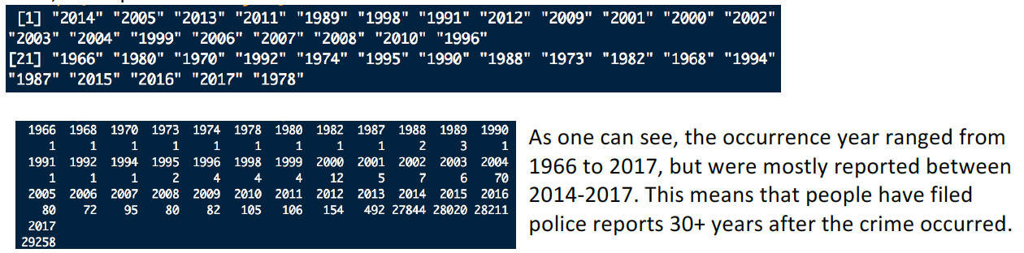
Data Preparation (Gathering, Cleaning & Preprocessing)
There are 131992 observations.
We proceed to remove duplicate values. Duplicate values may have been a consequence of data mining
We, then proceed to remove NA values
Now, we explore when these crimes occurred
We then Perform Dimensionality Reduction (Feature Selection) to remove unnecessary attributes that don’t add value to our work
Notes:
After further exploration, I am removing columns we do not need since they don't add any value to our research anymore: X, Y, Index_, ucr_code, ucr_ext, reporteddate, reportedmonth, reportedday, reporteddayofyear, reporteddayofweek, reportedhour, occurrencedayofyear, reportedyear, Division, Hood_ID, and FID

Slide 5
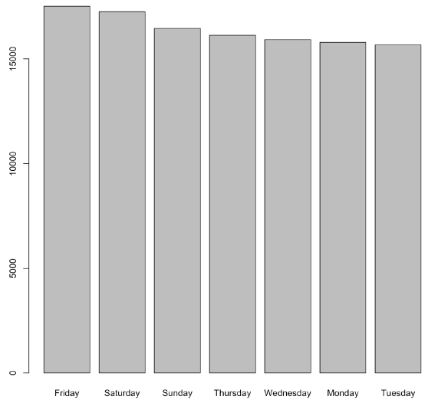
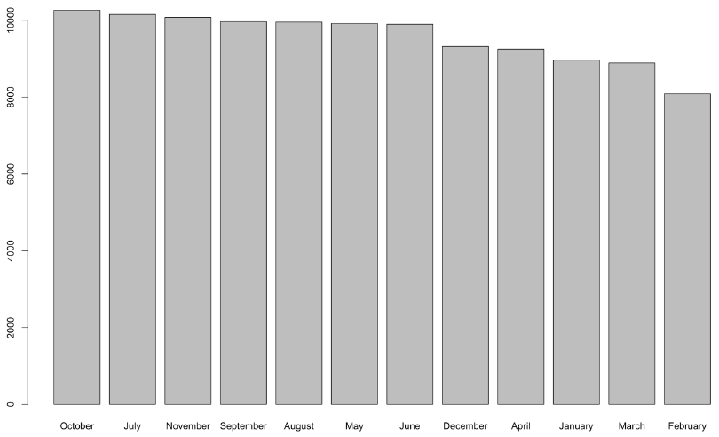
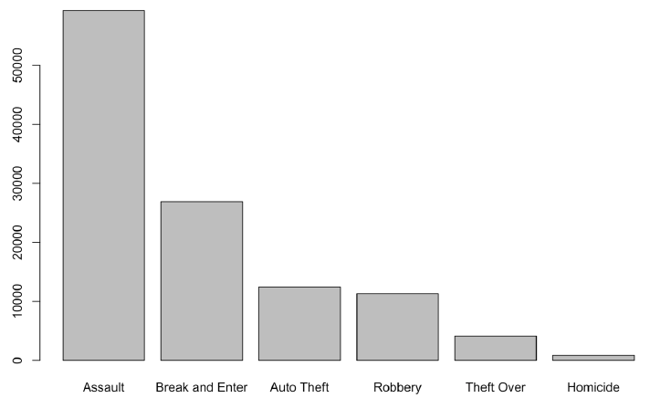
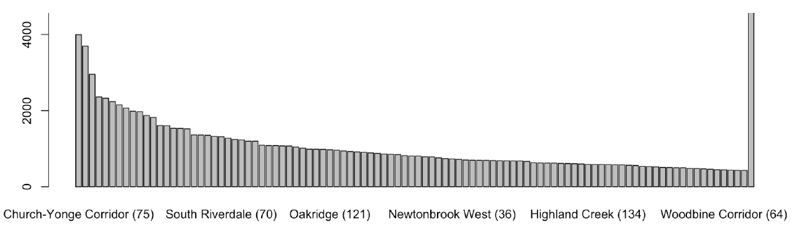
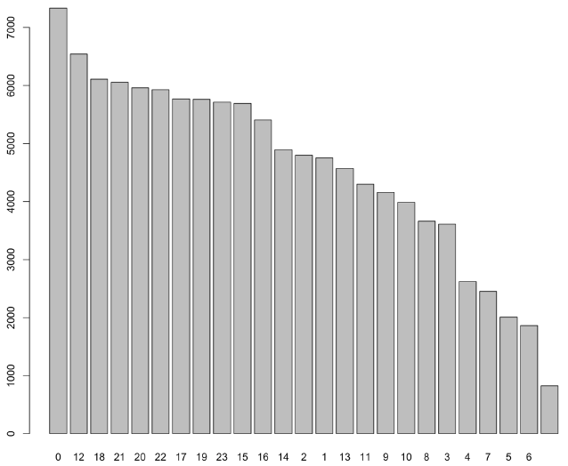
Initial Data Analysis
Notes:
Assault is the most common MCI (major crime indicator) occurring in Toronto. Break & Enter is the second most prevalent crime. Homicide is the least prevalent major crime in Toronto. As one can see from the graph, most crimes seem to occur on a Friday, followed by the Saturday, and Sunday. This may have something to do with the fact that it is the weekend, and a lot of people are out and about.
Most crimes occur in the month of October and the least amount of crimes in February. There seems to be a correlation as to when the crimes occur. Most crimes occur during the Spring/Summer, and the least amount of crimes occur during the Winter. Most crimes seem to have occurred in 2017. Since the data has been aggregated recently, this does not provide us with any useful information. One could infer that crime seems to be on the rise as the years go by.
We can see that most crimes occur at Church-Yonge Corridor. And, the least crimes occur at Thistletown-Beamond Heights.

Slide 6
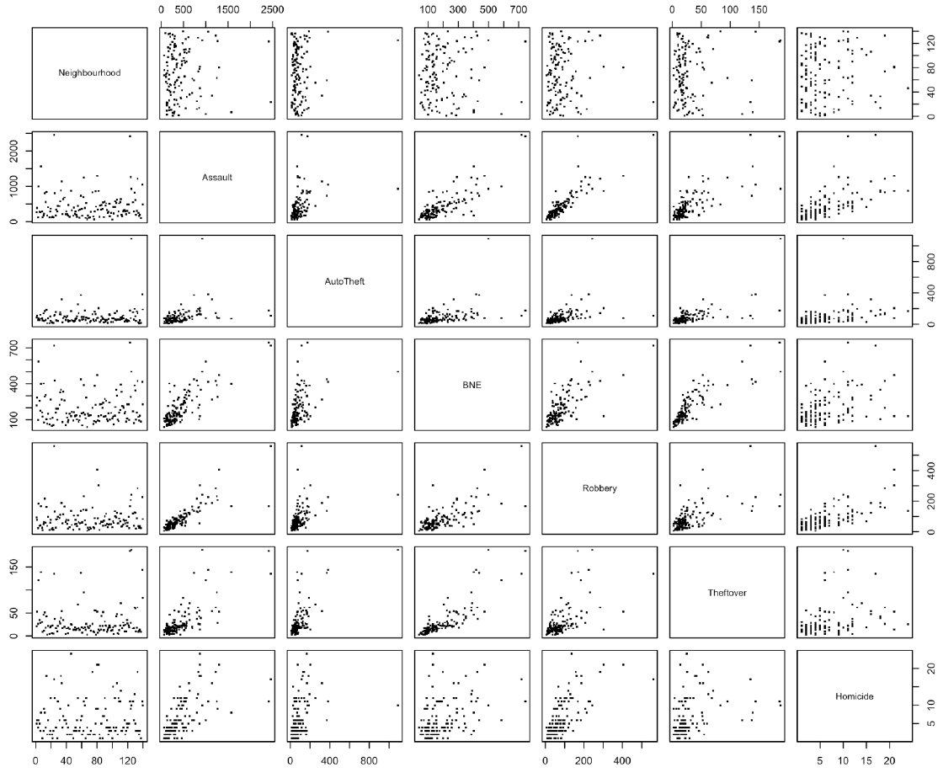
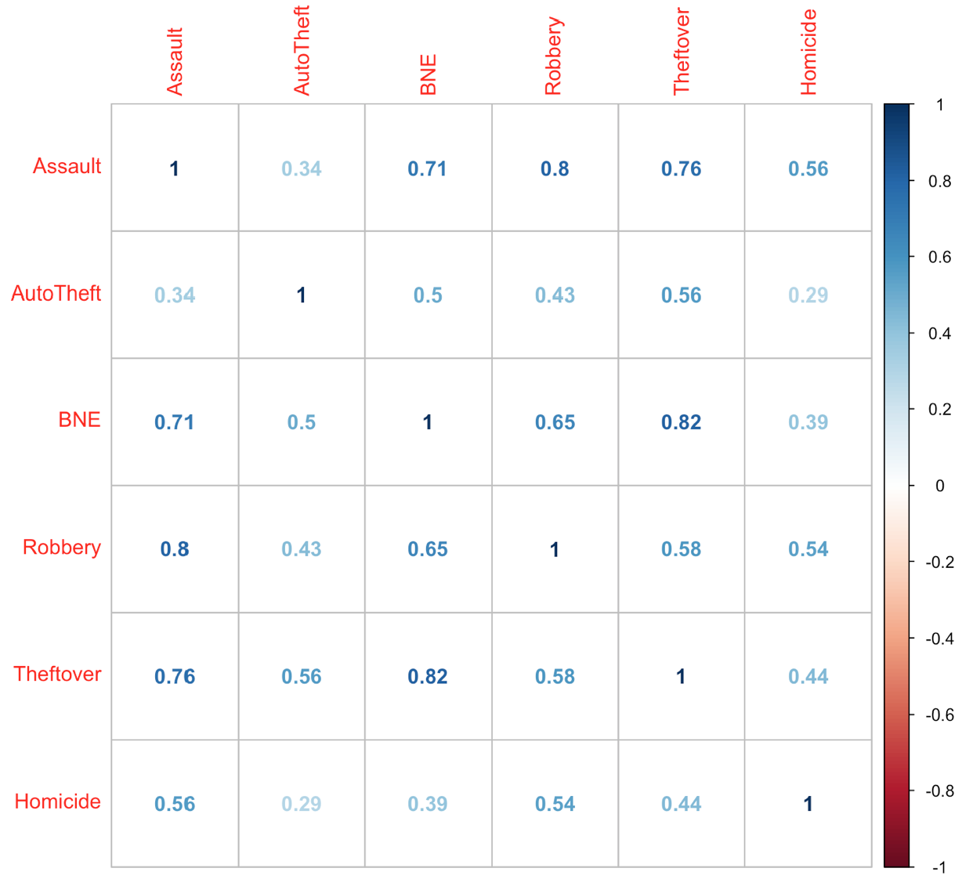
Initial Data Analysis cont.
Scatterplot Matrix
Correlation Matrix

Slide 7
Exploratory Data Analysis
For this particular dataset, we will look at 4 unsupervised learning ML algorithms:
1) Association Rules Mining (Apriori)
2) Association Rules Mining (Eclat)
3) K-Means Clustering
4) Hierarchical Clustering

Slide 8
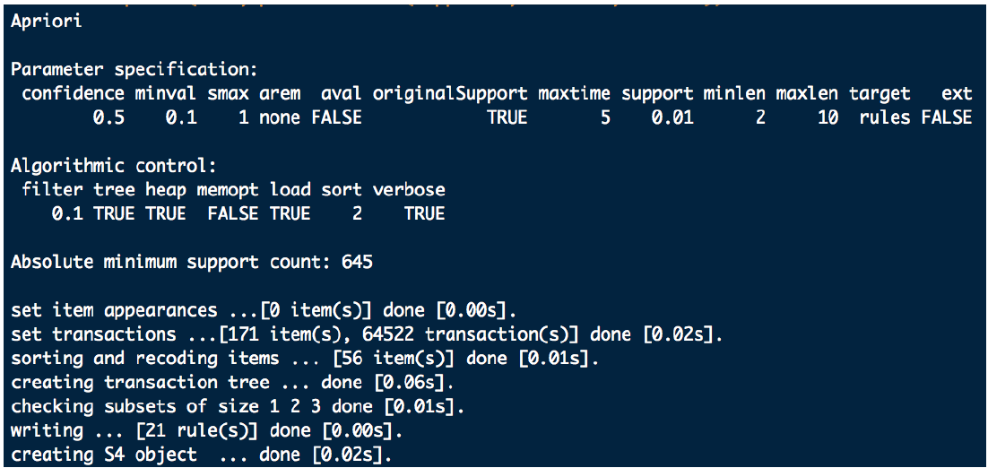
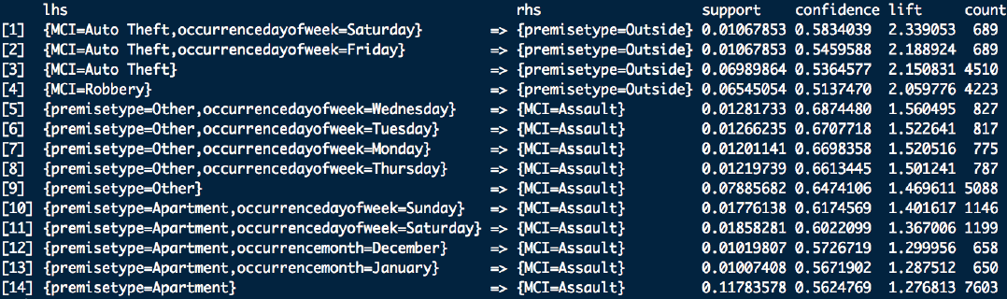
Association Rules Mining
(Apriori)
This algorithm helps find frequent item-sets in a dataset for Boolean association rule. Therefore, frequent items that appear in the dataset will be grouped together.
There are three factors to be considered when applying this algorithm:
Confidence, Support and Lift.
Notes:
For example, Look at Rule 14, 11% of the cases apartment and assault listed together. Hence, they co-exist together. Thus, we can frame the statement as: In 11% of the cases, we are 56% sure that when the premise is an Apartment, and Assault is most likely to occur. One can say of Rule 3 and Rule 4, that in 70% of the cases, we are over 50% sure that a Robbery or Auto-theft will likely occur Outside. Similarly, for Rule 11, we say that in 1.7% of the cases, we are 60% sure that an Assault occurs when the on a Wednesday in an Apartment setting.

Slide 9
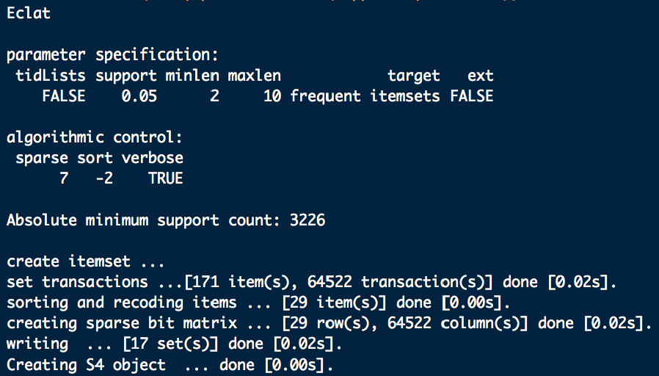
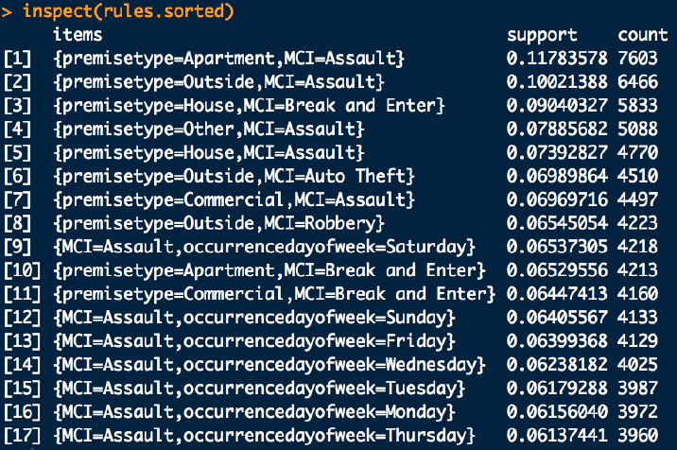
Association Rules Mining
(Eclat)
The eclat machine learning algorithm is very similar to the Apriori learning algorithm, except there is no confidence and lift. Instead, it is a simplified version of the Apriori algorithm.
It seems as though most these assaults occur in an Apartment setting. This is interpreted in Set#1
The next major premise where Assaults occur are Outside. This is interpreted in Set#2

Slide 10
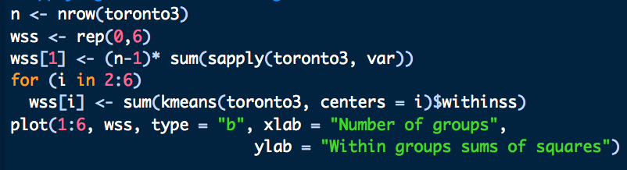
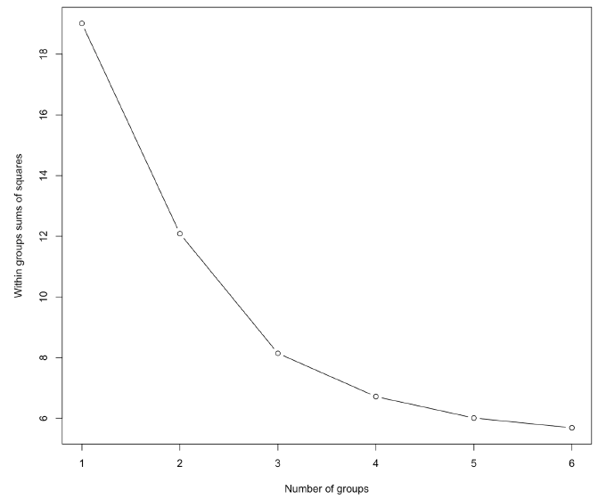
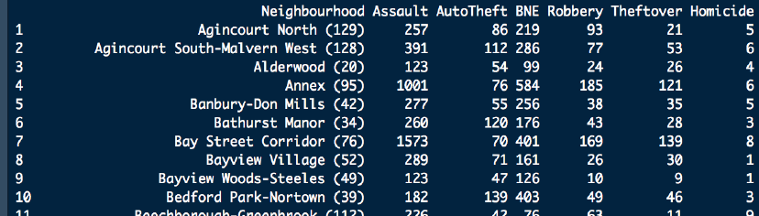
K-Means Clustering
the task of grouping together a set of objects in a way that objects in the same cluster are more similar to each other than to objects in other clusters.
Similarity is a metric that reflects the strength of relationships between two data objects. Using this logic, we will proceed to make inference from our dataset.

Slide 11
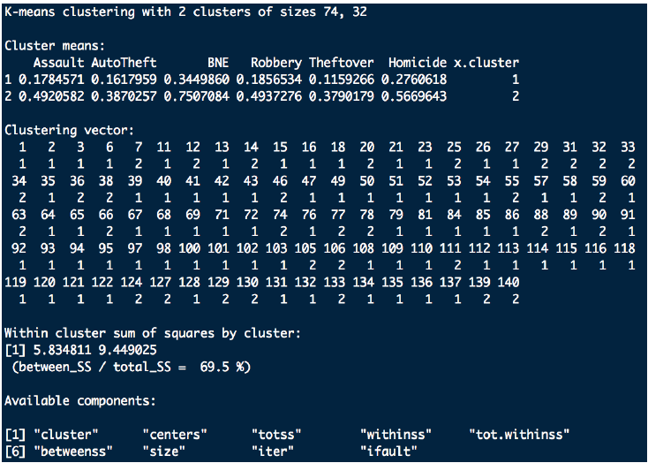
K-Means Clustering cont.
The first cluster has 47 neighborhoods. The second cluster has 32 neighborhoods.
Cluster means: The smaller values mean “lower than most” and bigger values mean “higher than most”.
Thus, cluster 1 has neighborhoods with low assault, low auto theft, low break and enter, low robbery and low theft over.
Cluster 2 has neighborhoods with high assault, high auto theft, high break and enter, high robbery and high theft over.
Notes:
It is good that these two groups have a significant variance in every variable, as it indicates that each variable plays a significant role in categorizing clusters.

Slide 12
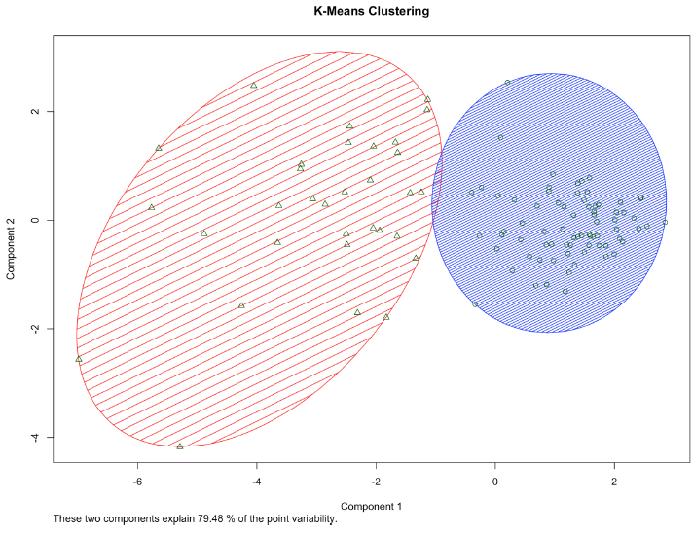
K-Means Clustering cont.
Explain Variability
List out all the dangerous neihbourhoods

Slide 13
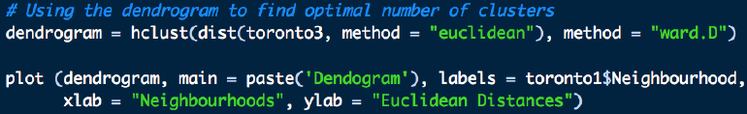
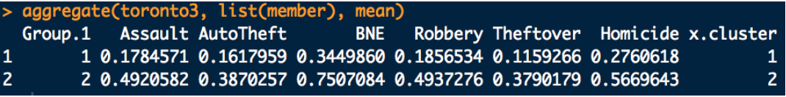
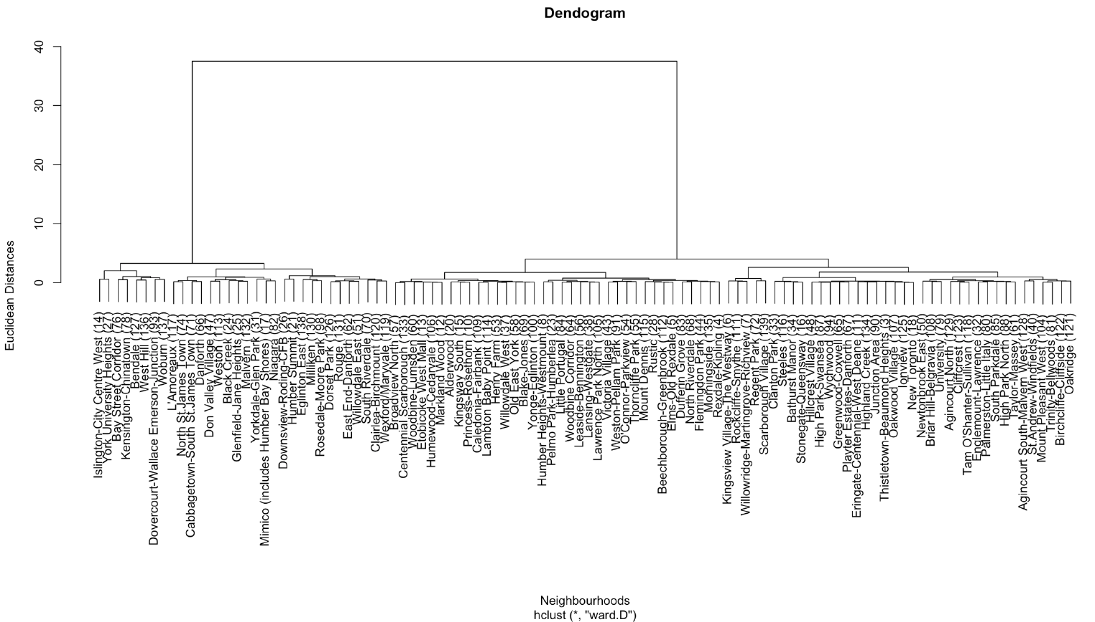
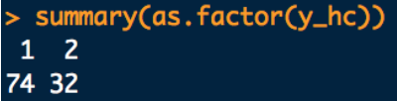
Hierarchical Clustering
Similar to the k-means algorithm, the first cluster contains values in the range of 0.1 – 0.3.
The second cluster contains values in the range of 0.5 – 0.7. This makes sense as it tells us that the first cluster contains relatively low crime compared to the second cluster with a higher crime rate range.
Therefore, Cluster 1 has lower Assault rates, lower Break & Enter rates, lower Homicide rates, compared to Cluster 2.
Notes:
In this method, unlike k-means, you don't need to specify a k parameter (i.e. a number of clusters). Instead, this algorithm builds clusters incrementally, producing a dendrogram. The algorithm begins by assigning each neighborhood to its own cluster. At each step, the two clusters that are the most similar are merged; the algorithm continues until all of the clusters have been merged, and thus a dendrogram has been produced.

Slide 14
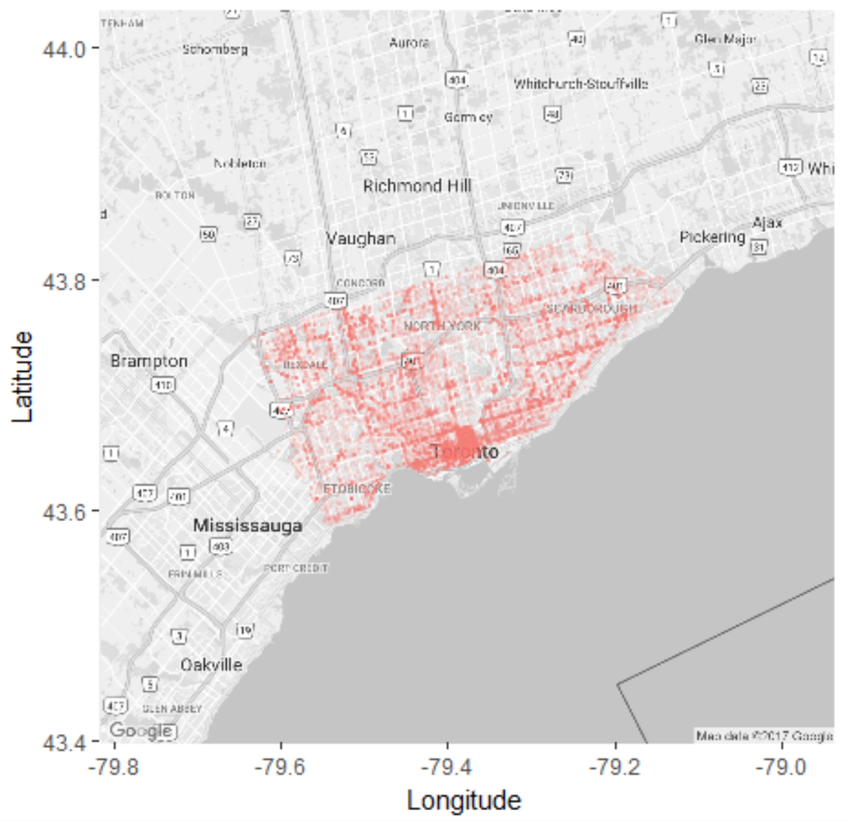
Conclusions & Recommendations
Source:
Most crimes occur on the Weekend
Most crimes occur at night
The most common kind of Crime is Assault
Dangerous Neighborhoods:
Most Assaults occur in an Apartment Setting.
Other ML Techniques to utilize:

Slide 15
THANK YOU! QUESTIONS?

